Slide 1
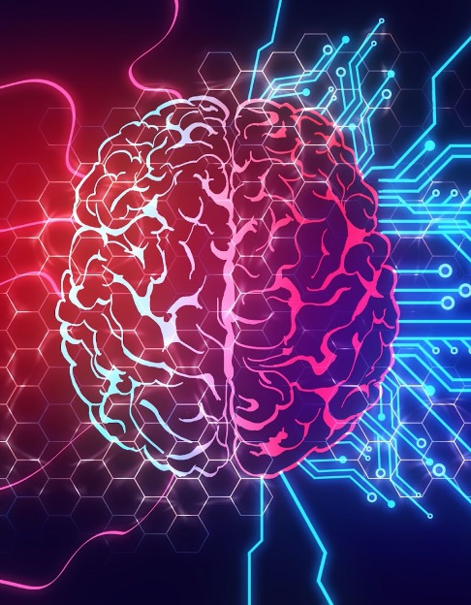
Selected - 2
Number Team : 47

Slide 2
Faculty Name : Computers and artificial intelligence Helwan
Team members’ IDs and names.
.1آلاء رضا عبدالحميد متولي 202000140
.2آية هاني قاسم توفيق 202000190
.3روان سعودى صلاح أحمد202000332
.4سارة سامح أبوبكر عبد الباسط 202000369
.5ميار أحمد السيد 202000965
.6هدى حامد مصطفى202001029

Slide 3
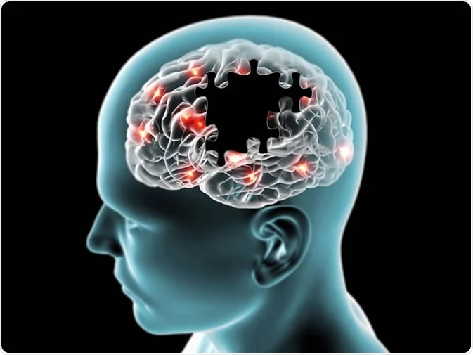
Paper details:
Authors name
Lamis F. Samhan, Amjad H. Alfarra, Samy S. Abu-Naser,
Ismail A.Amassi
paper name
Classification of Alzheimer's Disease Using Convolutional Neural Networks
year of publication
March – 2022
The dataset used
Alzheimer MRI Preprocessed Dataset (Kaggle)
the implemented algorithms
vgg16

Slide 4
Project Description Document
the name of the dataset
Alzheimer MRI Preprocessed Dataset (Kaggle)
the link of dataset
https://www.kaggle.com/datasets/sachinkumar413/alzheimer-mri-dataset
the total number of samples in the dataset
The dataset consists of 6400 MRI images
the dimension of images
128*128
number of classes and their labels
Class1: Mild Demented (896 images).
Class2: Moderate Demented (64 images).
Class3: Non Demented (3200 images).
Class4: Very Mild Demented (2240 images).

Slide 5
Implementation Details:
Ratio for
number of images
Training :
testing:
Training : 4480
testing: 1920
70
30

Slide 6
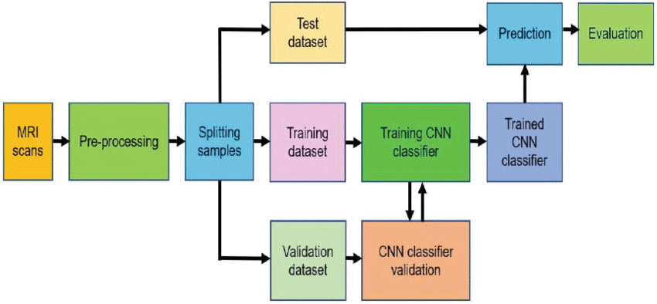






block diagram

Slide 7
Hyperparameters used:
Activation= relu ,softmax
learning_rate=0,0001
Optimizer:adam
Batch_size=64 batch
No. of Epochs= 10 Epoch.

Slide 8
Results Details:
1 - Training Loss & Validation Loss

Slide 9
2 - Taining Accuracy & Validation Accuracy

Slide 10
3 - Train Accuracies

Slide 11
4 - Train Loss

Slide 12
5 - Training Loss & Accuracy

Slide 13
1. Confusion Matrix:

Slide 14
Prediction

Slide 15
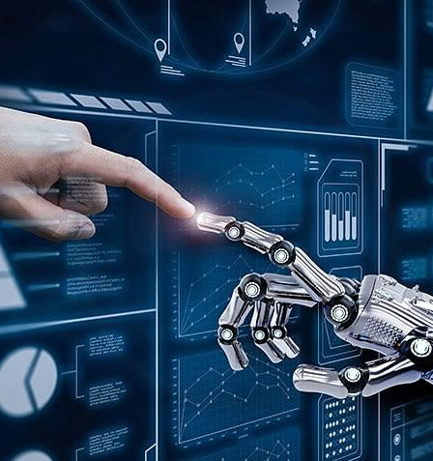
Thank you

